Slide 1
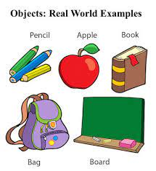
Properties & Methods
Objects in Java

Slide 2
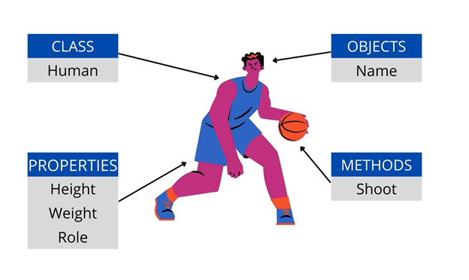
Object – Sanjay ( Class Humans)
Properties
Name
Age
Gender
Methods
Walk()
Dance()
Eat()
References : https://www.youtube.com/watch?v=3yOLNV9BF8A&pp=ygUPT2JqZWN0cyBpbiBKdmFh

Slide 3
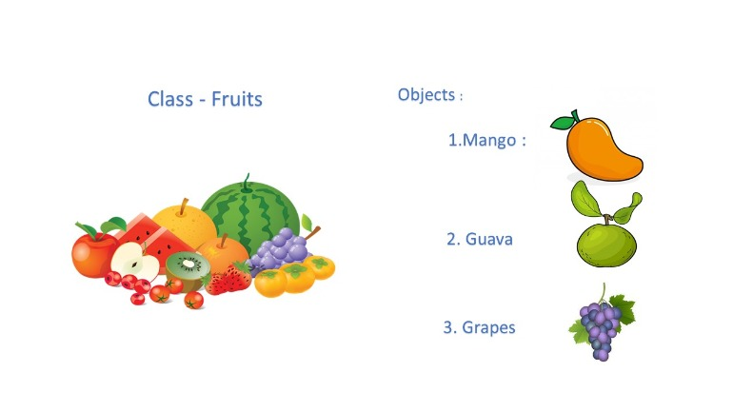
Object – Mangoes ( Class Fruits)
Properties
Colour
Size
Methods
Pluck()
GoodBad()
References : https://www.youtube.com/watch?v=3yOLNV9BF8A&pp=ygUPT2JqZWN0cyBpbiBKdmFh

Slide 4
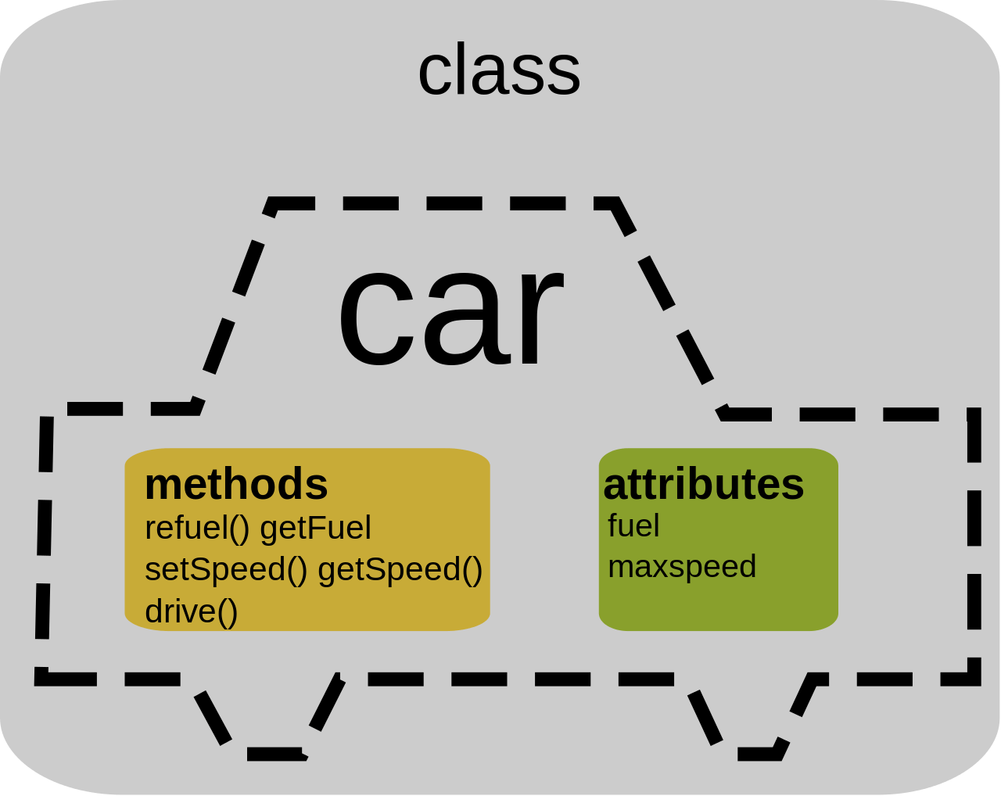
Object – Ferrari ( Class Cars)
Properties
Colour
Engine Model
Year
Seating Capability
Methods
Drive()
Speed()
StartEngine()
StopEngine()
References : https://www.youtube.com/watch?v=3yOLNV9BF8A&pp=ygUPT2JqZWN0cyBpbiBKdmFh

Slide 5
